Slide 1
Computer Science II Advanced C++
Spring 2019

Slide 2
Organizational Details
Class Meeting: CMPT102-01, 11:00am-12:15pm, Tuesday, Friday, RLC 105
CMPT102-02, 12:30pm-1:45pm, Tuesday, Friday, RLC 105
Instructor: Dr. Miaomiao Zhang
Office: RLC 203E
Phone: 718-862-3840
e-mail: mzhang01@manhattan.edu
[Put CMPT102 in subject line]
Office Hours:
Tuesday 10:00am – 11:00am, Friday 3:15pm – 4:15pm or by appointment.

Slide 3
Dr. Miaomiao Zhang: self-introduction
BS in EE from Southeast University (China), 2004
PhD in Computer Science from Stevens Institute of Technology, NJ, 2016
Areas of research: Theoretical and applied cryptography, privacy and network security, algorithm.

Slide 4
Textbook
Tony Gaddis, Starting Out with C++ from Control Structures to Objects, 9th Edition
ISBN13: 9780134498379
A very useful online resource (C++ tutorial) http://www.cplusplus.com/doc/tutorial/

Slide 5
Grading
Grading Scale:
95+ → A 90+ → A- 85+ → B+ 80+ → B
75+ → B-
70+ → C+
65+ → C
60+ → C-
50+ → D
50- → F
Grading Method
Pop Up Quizzes: 20%
Programming assignments: 45%
Midterm: 15%
Final: 20%

Slide 6
Important Principles
Honesty
Anything you turn in should be only your own work!
The world doesn’t need more people that cannot do anything useful!
Equality of Effort
I am willing to help you as much as you are willing to help yourself
Don’t expect me to fix things if you are unwilling to fix them yourself
Responsibility
You have a responsibility for your own learning
Know the policies for the course
Be always prepared for the class

Slide 7
Important Principles
One Rule: Do Not Disturb Others When You Learn!
It is your choice to learn and participate
Do not take that option out from others
So, phones off or at least volume down, music off or headsets volume down, voices down, no food and drinks in the computer lab (the latter is a College policy), etc.

Slide 8
Ways to Do Well
Computer Programming is a very practical area! To become a good programmer, it is very important to work on practical exercises yourself!
Only reading a book is not enough! This is like learning of a foreign language: only reading a text book and even memorizing a vocabulary is not enough to speak, write and understand
The same is in computer programming! You have to read a book and class notes. But to learn and develop your programming skills, you need to go through all programs considered in the class, to do practical exercises and design a code!
Do the assignments by yourself!
Ask questions if you don’t understand
Come to class on time
Be active in catching up if you miss a class

Slide 9
Interaction
Very important!
The only stupid question is the one that is left unasked. ASK! Any time when something is not clear…
Do not hesitate to ask!

Slide 10
C++
Advanced tools
and
Object Oriented Programming

Slide 11
User-defined functions in C++
More on Functions in C++

Slide 12
Useful Links to C++ tutorial
There are some useful hints and illustrations on the use of functions in C++
http://www.cplusplus.com/doc/tutorial/functions/

Slide 13
Functions
A function in programming is a "self contained" module of code that accomplish a specific task. Functions usually take in data (as input parameter(s)), process them, and return a result. Once a function is written, it can be used over and over and over again
Functions can be "called" from the inside of any other functions
Thus functions allow to structure programs in segments of code to perform individual tasks

Slide 14
Functional programming
Functional (procedural, modular) programming is a style of building the structure and elements of computer programs—that treats computation as the evaluation of mathematical functions and avoids changing-state and mutable data
In a functional code, the output value of a function depends only on the arguments that are input to the function, so calling a function f twice with the same value for an argument x will produce the same result f(x) each time

Slide 15
Functional programming
In a functional code, a program mostly consists of “bricks” – functions, which are called when it is necessary
Functional programming makes it possible to modify any function, change an algorithm used there, without affecting a main program and other functions where a function to be modified is used as long as parameters of this function remain the same
Functional programming makes it possible to create libraries of functions-tools frequently used in some certain area (e.g., Fourier transform, cosine transform, basic statistical analysis, etc. in signal processing)

Slide 16
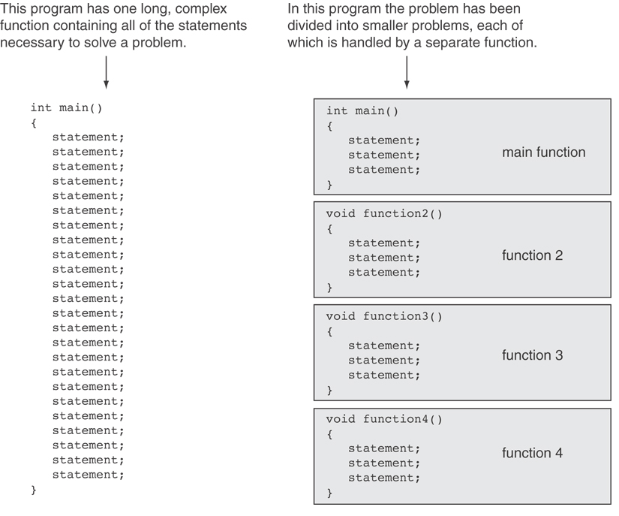

Slide 17
Formal and actual parameters
A function usually has arguments (formal parameters) listed in the parentheses right after its name and used for transferring input data into the function
name ( parameter1, parameter2, ...)
When a function is called, actual (calling) parameters corresponding to the formal parameters and matching their type shall be listed in exactly the same order
name (formal parameter1, formal parameter2, ...)
name ( actual parameter1, actual parameter2, ...)

Slide 18
Returning a Boolean Value
Function can return true or false
Declare return type in function prototype and heading as bool
Function body must contain return statement(s) that return true or false
Calling function can use return value in a relational expression

Slide 19
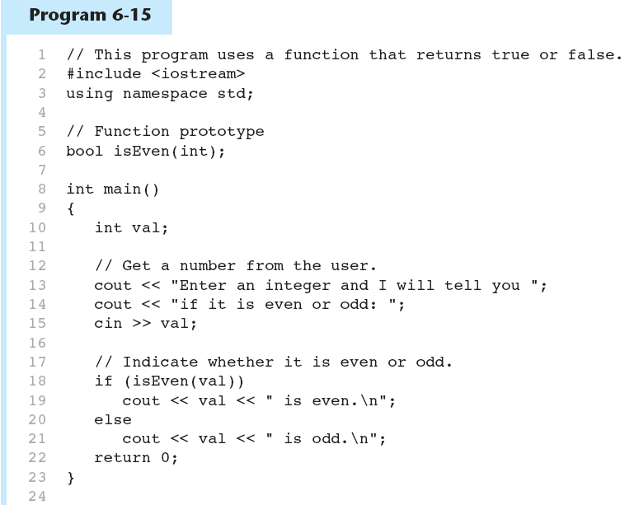
Returning a Boolean Value in Program 6-15
(Program Continues)

Slide 20
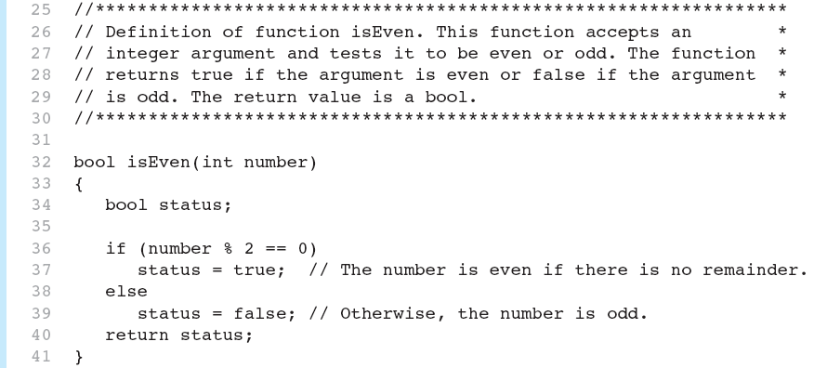

Returning a Boolean Value in Program 6-15

Slide 21
Function – Function Prototype
Function Prototype
Purpose:
Declares a function prior to the appearance of its code
Provides sufficient information for the compiler to check that the function is being called correctly
General form:
return_type function_name(parameter_declaration_list);
Prototype must be exactly the same as the heading in a function definition
Followed by a semicolon
Example: int maximum (int, int, int);
void display(void);

Slide 22
Function Prototypes
Ways to notify the compiler about a function before a call to the function:
Place function definition before calling function’s definition
Use a function prototype (function declaration) – like the function definition without the body
Header: void printHeading()
Prototype: void printHeading();

Slide 23
Parameters, Prototypes, and Function Headers
For each function argument,
the prototype must include the data type of each parameter inside its parentheses
the header must include a declaration for each parameter in its ()
void evenOrOdd(int); //prototype
void evenOrOdd(int num) //header
evenOrOdd(val); //call

Slide 24
Function – function prototype
#include <iostream>
using namespace std;
int sum(int, int); // function prototype
int main()
{
int total, a, b;
a = 2;
b = 3;
total = sum(a, b); //call function sum() to get sum of two numbers
cout << "sum of two numbers: “ << total;
return 0;
}
//function definition
int sum(int first, int second)
{
int Add;
Add = first + second;
// return a value to the main function
return Add;
}
Return type: int
Function name: sum
Parameter to be passed: int first, int second
Run:
sum of two numbers: 5

Slide 25
Prototype Notes
Place prototypes near top of program
Program must include either prototype or full function definition before any call to the function – compiler error otherwise
When using prototypes, can place function definitions in any order in source file

Slide 26
Function – overall program flow
#include <iostream>
using namespace std;
int sum(int first, int second); // function prototype
int main()
{
int total, a, b;
a = 2;
b = 3;
total = sum(a, b); //call function sum() to get sum of two numbers
cout << "sum of two numbers: “ << total;
return 0;
}
// function definition
int sum(int first, int second)
{
int Add;
Add = first + second;
// return a value to the main function
return Add;
}
Calling Function “sum()”
Return variable “Add” to the main Function

Slide 27
Function – no arguments
#include <iostream>
using namespace std;
int sum (void); // function prototype
int main()
{
int total;
total = sum(); //call function sum() to get sum of two numbers
cout << "sum of two numbers: “ << total << endl;
return 0;
}
//function definition
int sum(void)
{
int first, second, Add;
cout << "input the first number: ";
cin >> first;
cout << "input the second number: ";
cin >> second;
Add = first + second;
// return a value to the main function
return Add;
}
Calling Function “sum()”
Return variable “Add” to the main Function

Slide 28
Function – no return statement
Run:
program execution starts at the main function
function display has been called
return to the main function
#include <iostream>
using namespace std;
void display(void); //function prototype
int main(void)
{
cout << "program execution starts at the main function\n";
display(); // function call
cout << "return to the main function\n";
return 0;
}
// Following is function definition
void display(void)
{
cout << "function display has been called\n";
}

Slide 29
Function calls another function
#include <iostream>
using namespace std;
void TotalGrade();
void LetterGrade(double score);
int main()
{
TotalGrade();
return 0;
}
void TotalGrade()
{
double grade;
double total = 0.0;
double average = 0.0;
int counter = 0;
cout << "Enter exam score <-1 to end> --> ";
cin >> grade;
while(grade != -1)
{
total += grade;
counter++;
cout << "Enter exam score <-1 to end> --> ";
cin >> grade;
}
average = total / counter;
cout << "Average of all exams: “ << average ;
LetterGrade(average);
}
void LetterGrade(double score)
{
if(score >= 90)
cout << "Letter Grade: A";
else if(score >= 80)
cout << "Letter Grade: B";
else if(score >= 70)
cout << "Letter Grade: C";
else if(score >=65)
cout << "Letter Grade: D";
else
cout << "Letter Grade: F";
}
(2)
(1)
(4)
(3)

Slide 30
Local Variables
All variables and data structures declared inside a function are local. They exist only inside that function
For example, x in a function and x in a calling (main) program are different variables
This gives a programmer more flexibility and makes any function completely independent from calling programs where this function is used

Slide 31
Function Workspace
Every function has its own Workspace. This means that every variable inside a function is only usable during the execution of the function (and then the variables go away)
Having a separate Workspace for each function is critical to proper software engineering. If every function shared every variable in an entire program, it would be easy to inadvertently change the values of variables that you shouldn't. Further, it would be hard to remember what "names" have been used elsewhere, and coming up with new names to represent similar ideas would be challenging
Additionally, the function can only "see" the information that is "passed" to it via parameters. Thus the only way information can get "in" to the function is by using parameters

Slide 32
Local Variable Lifetime
A function’s local variables exist only while the function is executing. This is known as the lifetime of a local variable.
When the function begins, its local variables and its parameter variables are created in memory, and when the function ends, the local variables and parameter variables are destroyed
This means that any value stored in a local variable is lost between calls to the function in which the variable is declared

Slide 33
Global Variables and Global Constants
A global variable is any variable defined outside all the functions in a program
The scope of a global variable is the portion of the program from the variable definition to the end
This means that a global variable can be accessed by all functions that are defined after the global variable is defined

Slide 34
Global Variables and Global Constants
You should avoid using global variables because they make programs difficult to debug
Any global that you create should be global constants

Slide 35
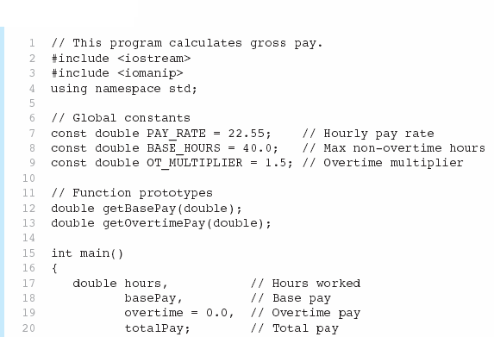

Global Constants in Program 6-19
Global constants defined for values that do not change throughout the program’s execution

Slide 36



Global Constants in Program 6-19
The constants are then used for those values throughout the program

Slide 37
Initializing Local and Global Variables
Local variables are not automatically initialized. They must be initialized by the programmer
Global variables (not constants) are automatically initialized to 0 (numeric) or NULL (character) when the variable is defined

Slide 38
Static Local Variables
Local variables only exist while the function is executing. When the function terminates, the contents of local variables are lost
static local variables retain their contents between function calls
static local variables are defined and initialized only the first time the function is executed. 0 is the default initialization value.

Slide 39
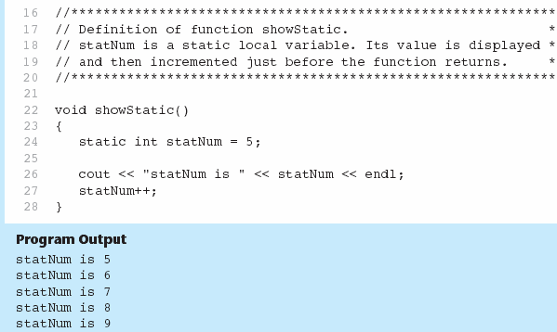
If you do initialize a local static variable, the initialization only happens once. See Program 6-23

Slide 40
Default Arguments
A default argument is an argument that is passed automatically to a parameter if the argument is missing on the function call
Must be a constant declared in prototype:
void evenOrOdd(int = 0);
Can be declared in header if no prototype
Multi-parameter functions may have default arguments for some or all of them:
int getSum(int, int=0, int=0);

Slide 41
Default Arguments
If not all parameters to a function have default values, the defaultless ones are declared first in the parameter list:
int getSum(int, int=0, int=0);// OK
int getSum(int, int=0, int); // NO
When an argument is omitted from a function call, all arguments after it must also be omitted:
sum = getSum(num1, num2); // OK
sum = getSum(num1, , num3); // NO

Slide 42
Exercise 1
Design a function named diff that can be used to calculate the absolute difference between two numbers.
The function shall have two formal parameters (int) and return a non-negative integer.
How to get the absolute value of difference?
If/else statement
ternary operator ?:
abs() function from <cstdlib>

Slide 43
Overloading Functions
Overloading functions have the same name but different parameter lists
In C++, two different functions can have the same name if their parameters are different; either because they have a different number of parameters, or because any of their parameters are of a different type
Can be used to create functions that perform the same task but take different parameter types or different number of parameters
Compiler will determine which version of function to call by argument and parameter lists

Slide 44
Function Overloading Examples
Using these overloaded functions,
void getDimensions(int); // 1
void getDimensions(int, int); // 2
void getDimensions(int, double); // 3
void getDimensions(double, double);// 4
the compiler will use them as follows:
int length, width;
double base, height;
getDimensions(length); // 1
getDimensions(length, width); // 2
getDimensions(length, height); // 3
getDimensions(height, base); // 4

Slide 45
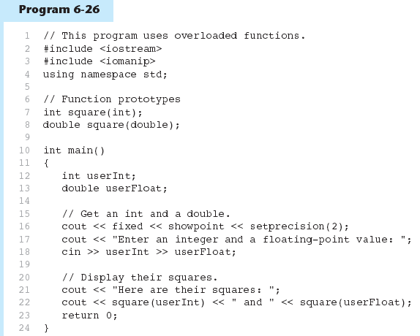

Function Overloading in Program 6-27
The overloading functions square have different parameter lists
Passing a double
Passing an int
(Program Continues)

Slide 46
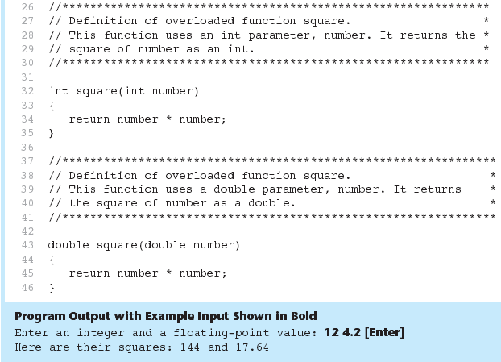
Function Overloading in Program 6-27

Slide 47
Overloading Functions
In this example, there are two functions called square, but one of them is int and have an int type parameter, while another one is double and has a double type parameter. The compiler knows which one to call in each case by examining the types passed as arguments when the function is called. If it is called with an int argument, it calls to the function that has an int parameter, and if it is called with a double argument, it calls the one that has a double parameter
Two functions with the same name are generally expected to have -at least- a similar behavior, thus to perform the same or about the same operation(s) applied to the different type data. This is not required, but if is expected. Otherwise a program can be slowed down

Slide 48
Overloading Functions – Important Remark
Note that a function cannot be overloaded only by its return type (thus different return type with the same parameters type does not work for overloading)
Hence it is important that at least one of parameters of each function from the same group of overloading functions with different return types must have a different type, typically matching the return type (when compared to other functions from the same group)

Slide 49
Exercise 2
Design an overloading function meanValue
for finding mean of two double numbers
For finding mean of three double numbers
Demonstrate the function in a program that prompts the user to enter two and three floating point numbers and employs the meanValue function to find their mean.

Slide 50
Introduction to Recursion
A recursive function contains a call to itself:
void countDown(int num)
{
if (num == 0)
cout << "Blastoff!";
else
{
cout << num << "...\n";
countDown(num-1); // recursive
} // call
}

Slide 51
What Happens When Called?
If a program contains a line like countDown(2);
countDown(2) generates the output 2..., then it calls countDown(1)
countDown(1) generates the output 1..., then it calls countDown(0)
countDown(0) generates the output Blastoff!, then returns to countDown(1)
countDown(1) returns to countDown(2)
countDown(2)returns to the calling function

Slide 52
What Happens When Called?
first call to
countDown
num is 2
output:
2...
countDown(1);
second call to
countDown
num is 1
1...
countDown(0);
third call to
countDown
num is 0
Blastoff!
// no
// recursive
// call

Slide 53
Recursive Functions - Purpose
Recursive functions are used to reduce a complex problem to a simpler-to-solve problem.
The simpler-to-solve problem is known as the base case
Recursive calls stop when the base case is reached
In programming, recursive functions can be used:
To implement some naturally recursive algorithm (which makes such a program highly efficient!)
Instead of a loop (which can be either efficient or very inefficient!)

Slide 54
Stopping the Recursion
A recursive function must always include a test to determine if another recursive call should be made, or if the recursion should stop with this call
In the sample program, the test is:
if (num == 0)

Slide 55
Stopping the Recursion
void countDown(int num)
{
if (num == 0) // test
cout << "Blastoff!";
else
{
cout << num << "...\n";
countDown(num-1); // recursive
} // call
}

Slide 56
Stopping the Recursion
Recursion uses a process of breaking a problem down into smaller problems until the problem can be solved
In the countDown function, a different value is passed to the function each time it is called
Eventually, the parameter reaches the value in the test, and the recursion stops

Slide 57
Stopping the Recursion
void countDown(int num)
{
if (num == 0)
cout << "Blastoff!";
else
{
cout << num << "...\n";
countDown(num-1);// note that the value
} // passed to recursive
} // calls decreases by
// one for each call

Slide 58
What Happens When Called?
Each time a recursive function is called, a new copy of the function runs, with new instances of parameters and local variables created
As each copy finishes executing, it returns to the copy of the function that called it
When the initial copy finishes executing, it returns to the part of the program that made the initial call to the function

Slide 59
What Happens When Called?
first call to
countDown
num is 2
output:
2...
countDown(1);
second call to
countDown
num is 1
return
1...
countDown(0);
third call to
countDown
num is 0
return
Blastoff!
// no
// recursive
// call
return

Slide 60
Types of Recursion
Direct
a function calls itself
Indirect
function A calls function B, and function B calls function A
function A calls function B, which calls …, which calls function A

Slide 61
Recursive Functions
#include "stdafx.h"
#include <iostream>
using namespace std;
int sum(int k) // recursive function sum
{ // calculates sum of the first k
int s = k; // positive integers
if (k > 1)
s = s + sum(k - 1); // recursive function call
else
return s;
}
int main(void)
{// Opening brace.
int k;
cout << "k=";
cin >> k;
cout << sum(k) << endl;
system("pause");
return 0;// End statement
}
#include "stdafx.h"
#include <iostream>
using namespace std;
int sum(int k) // non-rcursive function sum
{ // calculates sum of the first k int s = 0; // positive integers employing a for loop
for (int i=1; i<=k; i++)
s = s + i;
return s;
}
int main(void)
{// Opening brace.
int k;
cout << "k=";
cin >> k;
cout << sum(k) << endl;
system("pause");
return 0;// End statement
}

Slide 62
Recursive Functions
#include "stdafx.h"
#include <iostream>
using namespace std;
int GCD(int n, int m) // function for finding
{ // the greatest common divisor for n and m
int p, q; // according to the recursive Euclidian algorithm
if (n == 0) // if n = 0, then GCD = m
return m;
else if (m == 0) // if m = 0, then GCD = n
return n;
else // otherwise GCD(n, m) = GCD(m, n mod m)
{
p = n % m; // p = n mod m
q = GCD(m, p); // q = GCD (m, p) = GCD(m, n mod m)
}
}
int main()
{
int r, s, q;
cout << "Enter two integers..." << endl;
cin >> r >> s;
q = GCD(r, s);
cout << "The GCD of " << r << " and " << s << " is " << q << endl << endl;
system("pause");
return 0;// End statement
}
Euclidian recursive algorithm for finding a greatest common divisor of two integers:
and its C++ implementation

Slide 63
Exercise 3
Design the factorial function which takes an integer number as input and returns the factorial of this number.
// Function Prototype
int factorial (int);
Write a recursive version and test it with a driver program.
Write an iterative version (that uses a loop instead of recursion).

Slide 64
The exit() Function
Terminates the execution of a program
Can be called from any function
Can pass an int value to operating system to indicate status of program termination
Usually used for abnormal termination of program
Requires cstdlib header file

Slide 65
The exit() Function
Example: exit(0);
The cstdlib header defines two constants that are commonly passed, to indicate success or failure: exit(EXIT_SUCCESS); exit(EXIT_FAILURE);

Slide 66
C standard Library, and Math Library Functions
Functions in C++

Slide 67
C standard library
C programs consist of modules or pieces called functions
There is a rich collection of functions which were already defined in the C standard library
The functions in the C standard library are Standard Library Functions

Slide 68
Random numbers
Random numbers are widely used in different computer simulations.
They are very important for example, in
Filter design (simulation of noise)
Statistical simulations
Computer security
Computer gaming (simulation of rolling a dice, playing cards, etc.)

Slide 69
Mathematical Library Functions – Random Numbers
These require cstdlib header file #include <cstdlib>
rand(): returns a random number (int) between 0 and the largest int the computer holds. Yields same sequence of numbers each time program is run
srand(x): initializes random number generator with unsigned int x to change a sequence of numbers generated
To generate a sequence of random numbers, rand should be called in a loop

Slide 70
Mathematical Library Functions – Random Numbers
To limit the range of random numbers generated, the following approach should be used
y = (rand() % (maxValue – minValue + 1) + minValue where minValue – the lowest number in the range and maxValue – the highest number in the range

Slide 71
Mathematical Library Functions
Require cmath header file #include <cmath>
Take double as input, return a double
Commonly used functions:
sin | Sine
cos | Cosine
tan | Tangent
sqrt | Square root
log | Natural (e) log
abs | Absolute value (takes and returns an int)
fabs | Absolute value (takes and returns a double or float)

Slide 72
Mathematical Library Functions
Function | Description | Example
sqrt(x) | Square root of x | sqrt(900.0) is 30.0
exp(x) | Exponential function | exp(1.0) is 2.718282
log(x) | Natural logarithm of x (base e) | log(2.718282) is 1.0
log10(x) | logarithm of x (base 10) | log10(1.0) is 0.0
fabs(x) | Absolute value of x | fabs(-13.5) is 13.5
ceil(x) | Rounds x to the smallest integer not less than x | ceil(9.2) is 10.0
floor(x) | Rounds x to the largest integer not greater than x | floor(9.2) is 9.0
pow(x, y) | x raised to power y (x^{y}) | pow(2, 7) is 128.0
fmod(x, y) | Remainder of x/y as a floating-point number | fmod(13.657, 2.333) is 1.992
sin(x) | Trigonometric sine of x (x in radians) | sin(0.0) is 0.0
cos(x) | Trigonometric cosine of x (x in radians) | cos(o.0) is 1.0
tan(x) | Trigonometric tangent of x (x in radians) | Tan(0.0) is 0.0

Slide 73
Mathematical Library Functions
#include <cmath> // includes Math library
#include <iostream>
using namespace std;
int main(void)
{
cout << sqrt(900.0) << ‘\n’; // square root
cout << pow(2, 7)) << ‘\n’ ; // 2^7
cout << exp(1.0)) << ‘\n’; // e^1
cout << log(2.718282)) << ‘\n’; // ln e
cout << fabs(-13.5)); // |-13.5|
return 0;
}
Run:
30.00
128.00
2.72
1.00
13.50

Slide 74
Mathematical Library Functions
Run:
Enter two integer numbers to calculate X^Y: 2 4
2 raised to power of 4 (2^4) = 16
#include <cmath>
#include <iostream>
using namespace std;
int main(void)
{
int first, second, result;
cout << "Enter two integer numbers to calculate X^Y: ");
cin >> first, second;
result=pow(first,second);
cout << first << "raised to power of ",second, << “=“ << result);
return 0;
}

